Slide 1
Fuzzy Control for Pendulum
A report for Assignment 5
Group Number :25
Roll Number : 1501CS54
1821EE13, 1821ME18

Slide 2
Code Structure
Divided into 2 components
Front End (frontend.py) : GUI
Back End (backend.py) : Fuzzy Control

Slide 3
Back End
Following Functions 1. profile() : gives a profile for parameters passed
2. fuzzification() : Fuzzifies a given x for different literal variables
3. rules() : Define rules for fuzzy control
4. defuzzify() : Get the trapezoid areas and centroid for a given literal variable current
5. Compute Current : Computes the weighted sum of all the defuzzified trapeziums

Slide 4
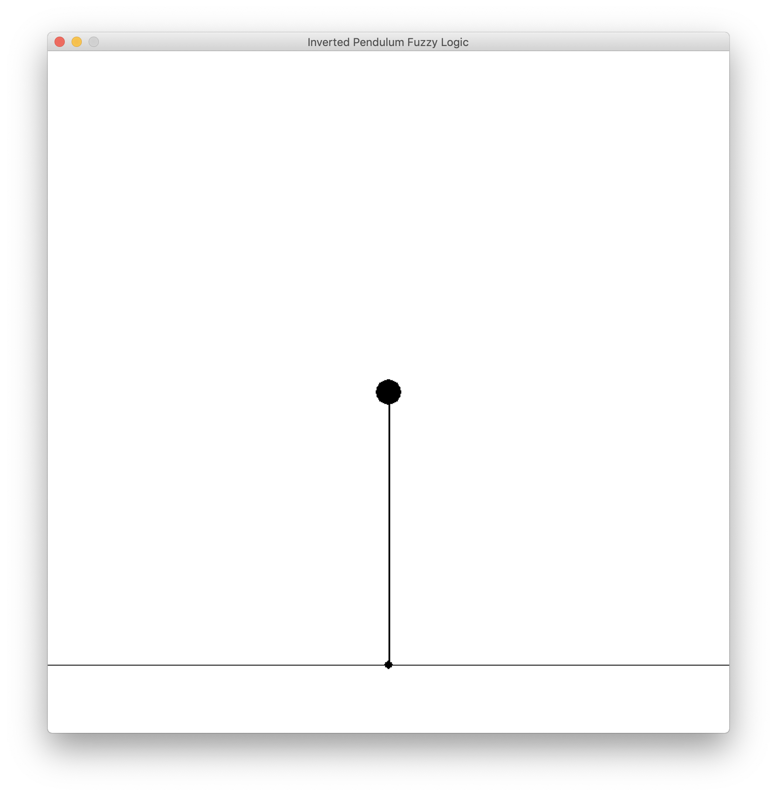
Front End
Responsible for all the GUI and the modification of the pendulum position and velocity
View of GUI

Slide 5
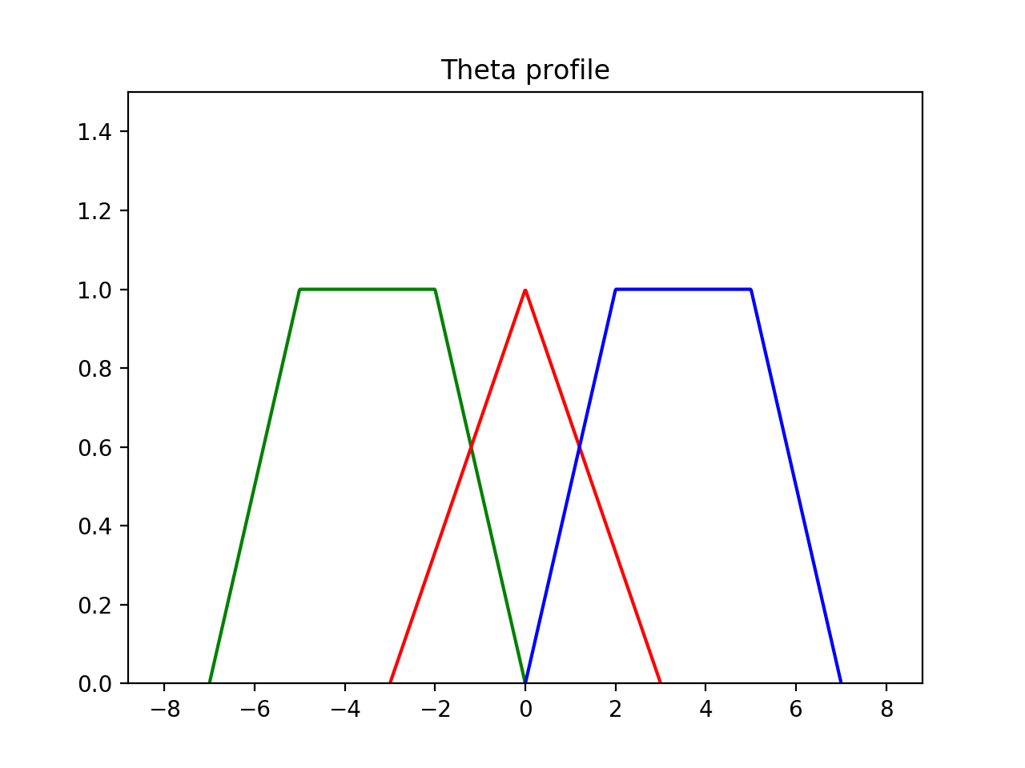
Theta Profile

Slide 6
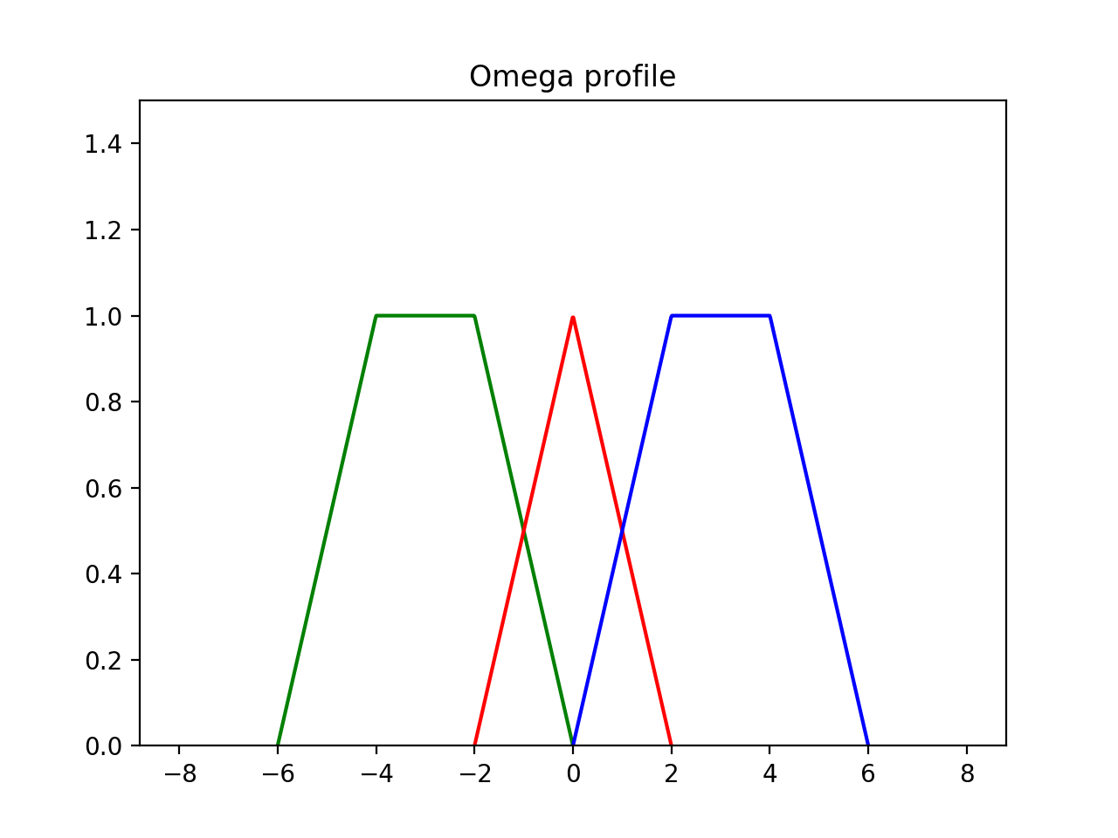
Omega Profile

Slide 7
Sample Run

